Slide 1

Gender PAY GAP in IT INDUSTRY
Project - DSC 530
Subhashini Natarajan
Nov 19, 2021

Slide 2
Objective
The objective of this project is to research and determine if gender pay gap exists in IT industry. Data source for the project is the salary survey conducted among IT employees in Europe. This dataset is available in the Kaggle link provided below.
https://www.kaggle.com/parulpandey/2020-it-salary-survey-for-eu-region

Slide 3
Dataset
There are three files of data with the surveys taken in 2018,2019 and 2020. The key variables observed in the dataset include,
Gender - Identifies if the person is male , female or diverse.
Experience Range – Number of years of work experience categorized in ranges 0-5, 6-10, 11-20, 20-25 and >25.
Role- Provides the role, the person performs in the company as a Developer, Analyst, QA or Manager.
Salary, Current & Prior – Provides the current annual salary and prior year annual salary in Euros.
Age – Age of the employee. Mostly age will be on par with experience, however if the employee joined the IT industry late or is in with a break, this field will help understand that.

Slide 4
Steps followed to perform EDA on the dataset
The following steps were followed in performing exploratory data analysis to find if gender pay gap exists in IT industry-
Data Ingestion - The three files were loaded into three independent dataframes.
Data profiling – Attributes in the dataframes were profiled to understand the list of unique values, presence of nulls etc.
Data Transformation – For inconsistent data values, necessary transformations were performed to make the data consistent in the three dataframes and then were combined into one with the fields deemed necessary.
Attributes were plotted to visually understand the data.

Slide 5
Steps followed to perform EDA on the dataset (continued)
Summary statistics were obtained to understand mean, median , mode, min, max and spread.
PMF of salary for male and female datasets determined and plotted.
CDF determined and plotted for male and female datasets to verify if female salary cdf is different than male salary cdf.
Pareto distribution was determined and plotted for male and female datasets.
Correlation analysis was performed between the variables.
T-Test was performed to verify if null hypothesis is true.
Simple and multiple linear regression performed on the dataset.

Slide 6
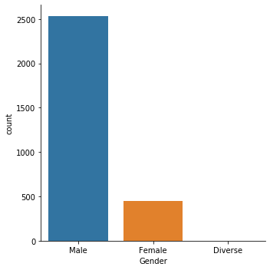
Visual observation of data
From the distribution it can be observed that the number of women employees in the survey is only one fifth of the male employees. It is assumed to be a true representation of the women in IT workforce.

Slide 7
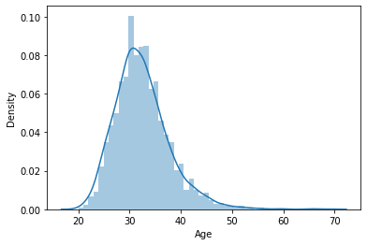
Visual observation of data
The plot provides the distribution of age group in the salary survey.
The plot is generated by distplot function from seaborn library.

Slide 8
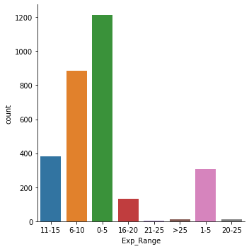
Visual observation of data
The plot provides the distribution of employees by the experience range. From the dataset it is observed that maximum number employees in the survey data is in the experience range 0-5. As compared with the prior chart where majority age group in the dataset was in 30s. This can indicate that they could have entered the IT workforce from a different career stream.
The plot is generated by catplot function from seaborn library.

Slide 9
Visual observation of data
The plot provides the distribution of employees by the experience range. From the dataset it is observed that maximum number employees in the survey data is in the experience range 0-5. As compared with the prior chart where majority age group in the dataset was in 30s. This can indicate that they could have entered the IT workforce from a different career stream.
The plot is generated by catplot function from seaborn library.

Slide 10
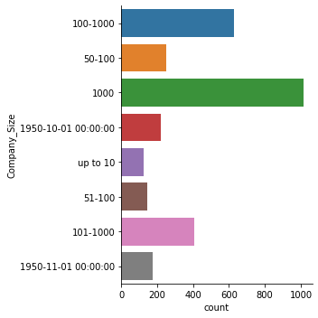
Visual observation of data
The plot provides the distribution of employees by the company size.
The plot clearly indicates that the field requires clean up.
The plot is generated by catplot function from seaborn library.

Slide 11
Summary statistics
Summary statistics for the numeric data in the dataset is as follows.
Age | Annual_Salary | Prior_Salary
count | 2780.00000 | 2993.00000 | 2084.00000
mean | 32.40108 | 33649436.44007 | 305317.16123
std | 5.40693 | 1827894112.95914 | 10951296.03375
min | 20.00000 | 6000.00000 | 0.00000
25% | 29.00000 | 58000.00000 | 55000.00000
50% | 32.00000 | 68000.00000 | 65000.00000
75% | 35.00000 | 80000.00000 | 75000.00000
max | 69.00000 | 99999999999.00000 | 500000000.00000

Slide 12
Summary statistics – contd.
 | Age | Annual_Salary | Prior_Salary
count | 1891 | 1891 | 1891
mean | 32.86462189 | 72192.35537 | 65439.54997
std | 5.242043263 | 21844.81898 | 26054.63898
min | 21 | 12000 | 0
0.25 | 29 | 60000 | 55000
0.5 | 32 | 70000 | 65000
0.75 | 36 | 80000 | 75000
max | 66 | 250000 | 760000
The statistics indicate the presence of outliers. The outliers tend to skew the dataset. Upon comparing the current and prior salary for all the three years the outlier data (2 records with salary 5000000K and 800000 were removed).
The summary statistics after the data clean up is to the right.

Slide 13
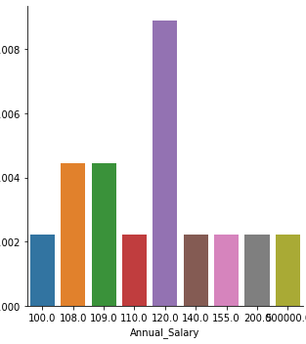
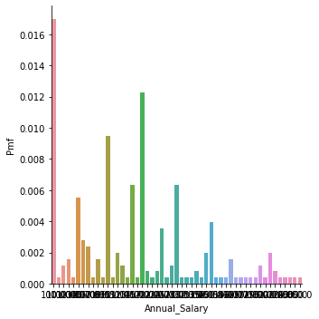
PMF plot for highest salary
PMF for male and female salary determined and plotted. Due to volume of dataset, considered salary above 100k for plotting. The plot for Female and Male employees are provided below –
The plots indicate that the highest probability of female employees to earn is 0.010, however, for a male employee is 0.018.
Female PMF plot
Male PMF plot

Slide 14
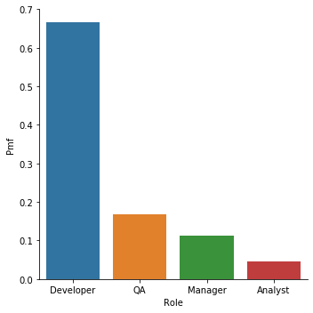
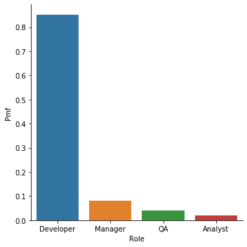
PMF PLOT for role between male/female employees
From the plot it is observed that the probability of women employees becoming QA is more than the probability of becoming Manager. Whereas for male employees the probability of becoming Manager is more than QA.
Female Role Distribution
Male Role Distribution

Slide 15
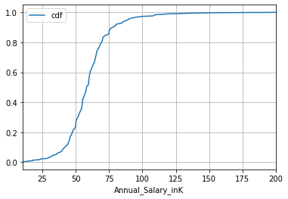
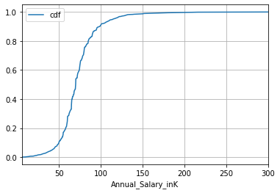
Salary CDF
Female salary CDF indicates that most of the pay is between 50K and 75K.
Male salary CDF indicates that most of the pay is between 50 and 100K.
Female Salary CDF
Male Salary CDF

Slide 16
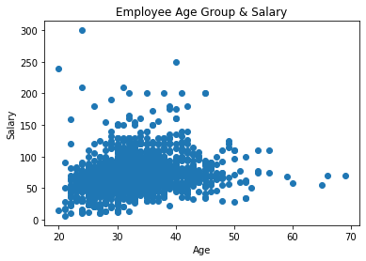
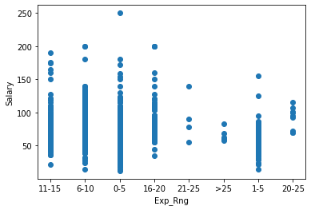
correlation
Scatterplot between age and salary. is represented. Plot indicates that higher salary is earned between 3—40 age group
Employees with experience Range 16-20 earn the highest salary.
Experience Range Vs Salary
Age Vs Salary

Slide 17
Correlation
The objective of the project is to determine the relationship between Gender and Salary. Gender being categorical data, the correlation between Gender and Salary is determined using Point Biserial correlation.
 | Gender_num | Annual_Salary_inK
Gender_num | 1 | 0.191272
Annual_Salary_inK | 0.191272 | 1

Slide 18
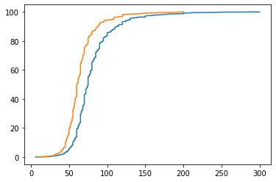
Pareto Analysis
Analytic distribution on salary data is performed using pareto analysis. Like CDF, pareto analysis indicate that majority female salary range is between 50K and 75K, whereas male salary range is between 50K and 100K.

Slide 19
Regression analysis
OLS Regression Results
Dep. Variable: | Annual_Salary_inK | R-squared: | 0.088
Model: | OLS | Adj. R-squared: | 0.085
Method: | Least Squares | F-statistic: | 26.02
Date: | Thu, 18 Nov 2021 | Prob (F-statistic): | 3.40E-34
Time: | 19:44:53 | Log-Likelihood: | -8427.2
No. Observations: | 1891 | AIC: | 1.69E+04
Df Residuals: | 1883 | BIC: | 1.69E+04
Df Model: | 7
Covariance Type: | nonrobust
coef | std err | t | P>|t| | [0.025 | 0.975]
Intercept | 68.0602 | 0.747 | 91.074 | 0 | 66.595 | 69.526
Exp_Range[T.1-5] | -8.7129 | 1.89 | -4.611 | 0 | -12.419 | -5.007
Exp_Range[T.11-15] | 9.4342 | 1.492 | 6.324 | 0 | 6.509 | 12.36
Exp_Range[T.16-20] | 19.7557 | 2.281 | 8.66 | 0 | 15.282 | 24.23
Exp_Range[T.20-25] | 23.3842 | 7.006 | 3.338 | 0.001 | 9.644 | 37.124
Exp_Range[T.21-25] | 22.6898 | 10.476 | 2.166 | 0.03 | 2.145 | 43.235
Exp_Range[T.6-10] | 7.5765 | 1.14 | 6.645 | 0 | 5.34 | 9.813
Exp_Range[T.>25] | -2.5602 | 8.564 | -0.299 | 0.765 | -19.356 | 14.236
Omnibus: | 779.1 | Durbin-Watson: | 2.002
Prob(Omnibus): | 0 | Jarque-Bera (JB): | 6252.755
Skew: | 1.73 | Prob(JB): | 0
Kurtosis: | 11.209 | Cond. No. | 23.3
The simple regression analysis between Exp Range and Salary is represented. F statistic value of 26.02. The high F stat value indicate strong relationship between Exp Range and Salary.

Slide 20
Regression analysis
OLS Regression Results
==============================================================================
Dep. Variable: Annual_Salary_inK R-squared: 0.113
Model: OLS Adj. R-squared: 0.109
Method: Least Squares F-statistic: 29.94
Date: Thu, 18 Nov 2021 Prob (F-statistic): 2.27e-44
Time: 19:59:57 Log-Likelihood: -8401.2
No. Observations: 1891 AIC: 1.682e+04
Df Residuals: 1882 BIC: 1.687e+04
Df Model: 8
Covariance Type: nonrobust
======================================================================================
coef std err t P>|t| [0.025 0.975]
--------------------------------------------------------------------------------------
Intercept 69.7500 0.773 90.187 0.000 68.233 71.267
Exp_Range[T.1-5] -7.7792 1.869 -4.163 0.000 -11.444 -4.114
Exp_Range[T.11-15] 8.6233 1.476 5.842 0.000 5.728 11.518
Exp_Range[T.16-20] 18.7050 2.255 8.293 0.000 14.281 23.128
Exp_Range[T.20-25] 21.6945 6.916 3.137 0.002 8.130 35.259
Exp_Range[T.21-25] 21.0000 10.338 2.031 0.042 0.725 41.276
Exp_Range[T.6-10] 6.9745 1.128 6.183 0.000 4.762 9.187
Exp_Range[T.>25] -2.5816 8.450 -0.306 0.760 -19.153 13.990
Female -10.0105 1.383 -7.238 0.000 -12.723 -7.298
==============================================================================
Omnibus: 804.630 Durbin-Watson: 2.002
Prob(Omnibus): 0.000 Jarque-Bera (JB): 6909.986
Skew: 1.776 Prob(JB): 0.00
Kurtosis: 11.665 Cond. No. 23.5
==============================================================================
When regression analysis is performed by adding Gender as an independent variable to the regression. The results with Gender female having a value -10 indicates that female salary is lesser than male salary.

Slide 21
T-TEST
Hypothesis : Gender Pay gap exists in IT industry
To test the hypothesis, performed T-Test.
Summary statistics between Male and Female datasets.
 | Annual_Salary_inK
count | mean | std | min | 25% | 50% | 75% | max
Gender
Female | 264 | 61.477 | 18.92 | 12 | 50 | 60 | 68 | 200
Male | 1626 | 73.879 | 21.70 | 14 | 62 | 71.625 | 82 | 250

Slide 22
Assumption validation
T-Test requires the assumption of normality and homogeneity to be true.
Assumption of Normality is verified using shapiro test.
0.8340311646461487, 3.9997917502840688e-16)
Assumption of homogeneity is verified using Levene’s test.
LeveneResult(statistic=5.146387144375454, pvalue=0.02340726016639203)

Slide 23
T-Test results
Ttest_indResult(statistic=8.759985992836686,
pvalue=4.255770985606472e-18)
Lower P value indicates that null hypothesis is not true and Alternative hypothesis is true. Hence it is concluded that gender pay gap exists between male and female employees and regression results indicate that female employee salary is lesser than the male employee salary.

